Slide 1
Strong list coloring, Group connectivity and the Polynomial method
Michael Tarsi, Blavatnik School of Computer Science, Tel-Aviv University, Israel

Slide 2
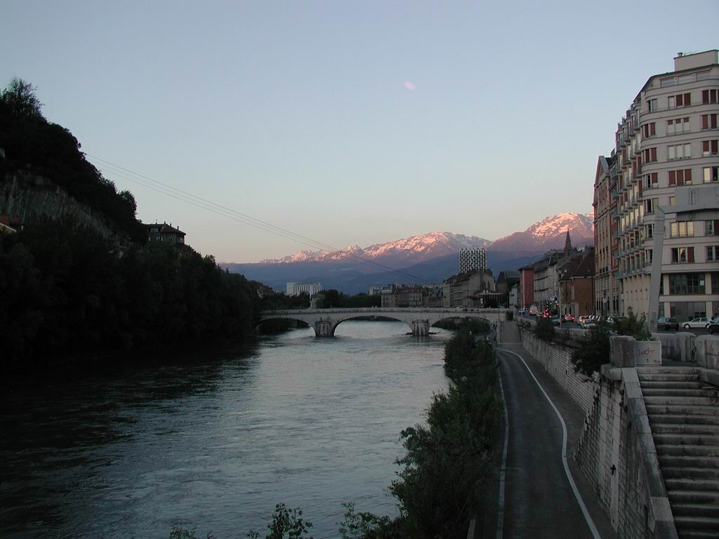

Slide 3
The Polynomial Method (Alon, T)
The Graphic case
PG=Π(xi – xj) over all edges (i,j)∈E
A proper coloring of G ⇔ an assignment of “colors” to the xi’s for which PG≠0

Slide 4
The main Algebraic tool
P(x₁,x₂,…,x_{n}) homogeneous
Cx₁^{e1}x₂^{e2}…x_{n}^{en} a monomial in the expansion of P, with a nonzero coefficient C≠0
More than e_{i} values to select a “color” from, for each x_{i}
⇒
There exists a “proper coloring” , that is, a feasible vector X such that P(X)≠0
(A multivariate version of “A polynomial of degree n has at most n distinct roots”)

Slide 5
An amazing application

Slide 6
Too Strength ⇒ Too weak
The (graphic) polynomial method is about List coloring (choosability)
Furthermore, It is about Strong list coloring
That is, each edge e has its own “forbidden difference” b_{e} between the two “colors” of its endvertices, not necessarily 0.

Slide 7
Proof:
For every edge e a new variable b_{e.} P~_{G} the product over E of (x_{i} –x_{j} – b_{e}).
P~k₃=(x-y-b₁)(y-z-b₂)(z-x-b₃)
P~ Clearly contains all terms of P_{G,} (e.g. x²y), where the exponent of each b_{e} is 0. Any single value can hence be imposed on each b_{e,} by the main Algebraic tool.
(A multivariate version of “A polynomial of degree n cannot rich the same value more than n times”)

Slide 8
Strong Choosability is indeed strong
e.g. unlike mere chosability (and coloribility), strong choosability does count multiple edges.

Slide 9
The Co-graphic case
Nowhere Zero flows
Definition (Tutte 1956)
A k-Nowhere Zero Flow in a graph is an assignment of a {1,2,…,k-1} value to every edge, such that the (directed) sum at each vertex (hence, every cut set) equals zero.

Slide 10
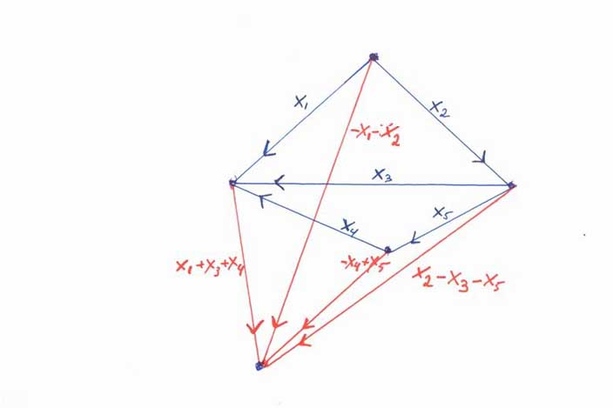
PG*=x₁x₂x₃x₄x₅(x₁+x₃+x₄)(-x₁-x₂)(-x₄+x₅)(x₂-x₃-x₅)
PG*≠0 ⇒NZF

Slide 11
We have a problem

Slide 12
Solution
Let it all be modulo k

Slide 13
But “A pol. of degree n has at most n roots” is essential.

Slide 14
Hence, limited to Fields, GF_{k}, when k is a prime power
2,3,4,5,..7,8,9… Good enough.

Slide 15
Group connectivity
Again, what we actually get is MORE than mere NZF:
Definition (Jaeger, Payan, Linial, T)
Let A be an abelian group. A graph is “A-connected” if for any assignment of forbidden values, one for each edge, there exists a feasible A-flow.

Slide 16
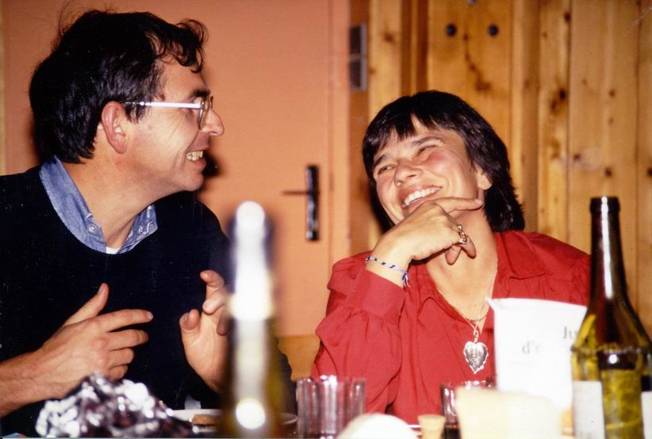

Slide 17
Example
Any even wheel is Z₃ connected
Proof by example:
PW4*=xyzt (x-y)(y-z)(z-t)(t-x), and 2x²y²z²t² is a monomial in its expansion

Slide 18
Interesting
Any even wheel is also Strongly Z₃-choosable
Proof:
A k-coloring is an assignment of values from sum abelian group of order k, to EDGES, which sums up (with some arbitrary orientation) to zero on every cycle.

Slide 19
Via matrix representation
P_{K4}=(x-y)(x-z)(x-w)(y-z)(y-w)(z-w)
=Π^{n}_{i=1} Σ^{m}_{j=1} ai,jXj
x y z w
1 -1 0 0
1 0 -1 0
1 0 0 -1
0 1 -1 0
0 1 0 -1
0 0 1 -1

Slide 20
The General case
Given an nxm matrix A=(ai,j), its polynomial PA is defined by Π^{n}_{i=1} Σ^{m}_{j=1} ai,jXj
P_{A}(X) is the product of the n entries of the vector AX
Originally motivated by:
Conjecture (Jaeger ~1980): For every Non singular nxn A over GFq, where q≥4, there exists a vector X, such that both X and AX have no zero entry.
True for every non prime q (Alon, T)

Slide 21
Matrix manipulations
Replacing A by AT, where A is non singular mxm means “change of variables”.
Over GF_{k,} the new matrix and its polynomial are as good as the original.
The chromatic number, NZF number, group connectivity and more, are all, in that sense, classical 19th century algebraic INVARIANTS
(though, mostly over finite fields).
Changing variables does help. e.g. (x-y)(x+y) quadratic→ xy linear

Slide 22
Seymour (1981), gave the following structural characterization of 3-connected cubic graphs on 2n vertices and 3n edges:
The entire graph can be obtained from a certain co-tree by repeatedly adding cycles, each containing at most two new edges.

Slide 23
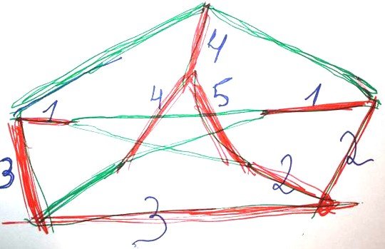

Slide 24
When algebraically translated
and after an appropriate change of variables, it gives a co-graphic matrix representation of the following type (sort of):
1 0 0 0
Identity matrix 0 1 0 0 representing
0 0 1 0
0 0 0 1
1 0 0 0
Triangular x 1 0 0 a tree
x x 1 0
x x x 1
y y y y
Non singular y y y y the corresponding
y y y y co tree
Y y y y

Slide 25
On 1987 we “proved” that, over GF₅, for such a matrix A, there exists a vector x such that Ax has no zero entry.
This “result” positively “settled” Tutte’s 5-NZF Conjecture, still open for almost 50 years.
We “proved” more:

Slide 26
The Tree plus 2-degenerate graph conjecture
A graph is (1,2)-composed if its edge set is the union of a spanning tree and a 2-degenerate graph.

Slide 27
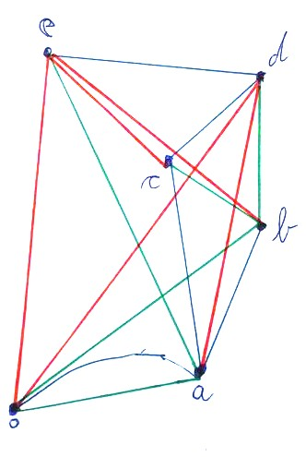
Example
0 a b c d e
-1 1 0 0 0 0
0 -1 1 0 0 0
0 -1 0 1 0 0 BLUE
0 0 0 -1 1 0
0 0 0 0 -1 1
-1 1 0 0 0 0
-1 0 1 0 0 0
0 0 -1 1 0 0 GREEN
0 0 0 -1 1 0
0 -1 0 0 0 1
And a non-singular READ

Slide 28
Conjecture(s)
The polynomial of a “Non-singular + Triangualr” Matrix admits a term where all exponents are at most 3.
The above Implies:
2. Every 3-connected graph is Z₅-connected, in particular, the assertion of Tutte’s 5-NZF conjecture.
Every (1,2)-composed graph is Strongly 5-choosable, in particular 5-choosable, in particular 5-colorable.
Either 2 or 3, strong or week version, may be true while the other wrong

Slide 29
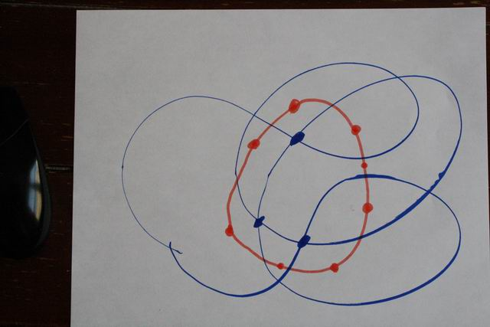

Slide 30
Some of Tutte’s Seminal Conjectures
There exists a positive integer k, such that every (bridgeless) graph admits a k-NZF
Every graph admits a 5-NZF
There exists a positive integer t, such that every t-edge connected graph admits a 3-NZF
Every 4-edge connected graph admits a 3-NZF

Slide 31
The 8-NZF Theorem (F.Jaeger 1975)
Every graph admits an 8-NZF
Equivalently, every graph can be covered by three Cycles (a cycle = an edge disjoint union of simple circuits)

Slide 32
The 6-NZF Theorem (P. Seymour 1981)
Every graph admits a 6-NZF

Slide 33
Conjecture (1987)
The Union of a tree and a 2-degenerate graph is always 5-colorable.

Slide 34
A Stronger version
For any pair of nxn non singular A and B there exists an nxn sub matrix of the nx2n A|B, with no zero Permanent.
If True over GF3 it implies Tutte’s 3-NZF Conjecture, with t=6

